Slide 1
Going back to in person events
Konstantinos Minas – Head of Education and Learning
Notes:
This workshop is funded via the ScotPEN Wellcome Engagement Award (SWEA), which is a devolved pilot of Wellcome's Research Enrichment for Public Engagement Funding in Scotland. A survey of training needs by the SWEA team highlighted going back to in-person events as a priority topic. (OPTIONAL )Further detail of past and forthcoming workshops can be found on the SWEA training page of the ScotPEN.org website; https://www.scotpen.org/swea-public-engagement-training

Slide 2
Overview
Why should we change from digital to in person delivery?
Events etiquette: How to choose the appropriate event format and venue
Health and Safety considerations before and during the event, including information on “Hygiene Theatre” and dynamic risk assessments
Effective communication with community leaders and attendees
Feedback and post event evaluation

Slide 3
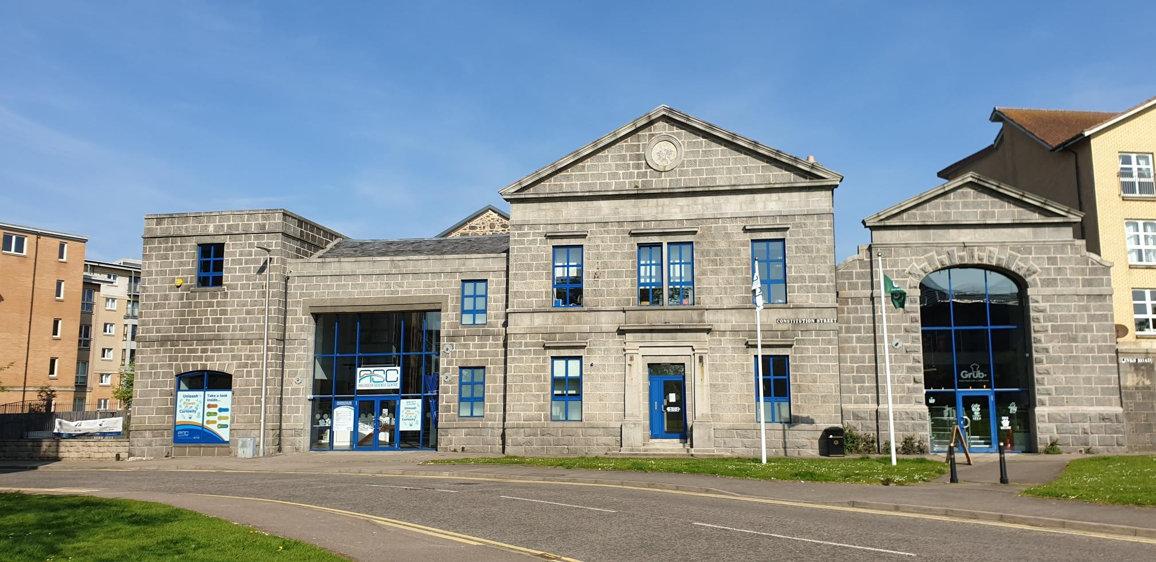
Aberdeen Science Centre (since 1989)

Slide 4
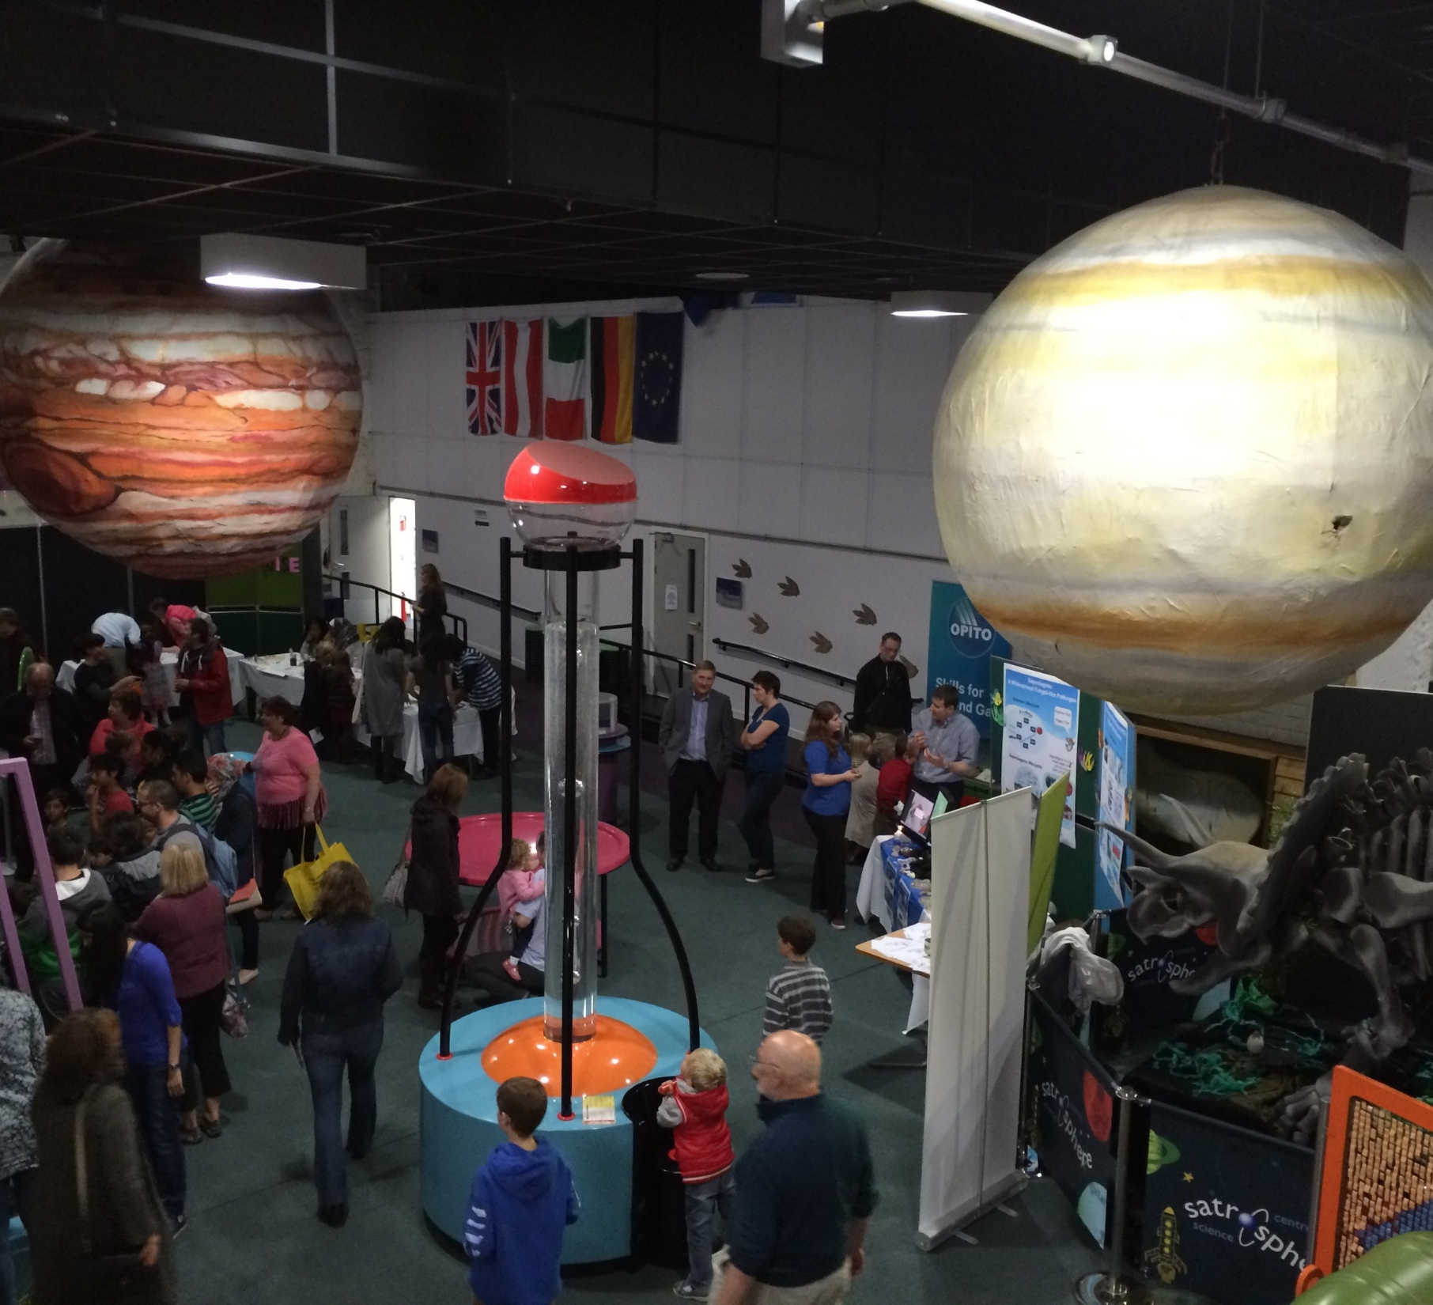
Successfully bidding for an “Inspiring Science” grant, meant that we went from this…

Slide 5
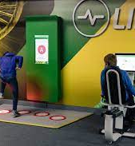
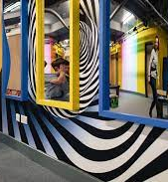
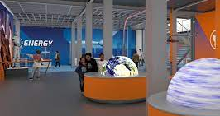
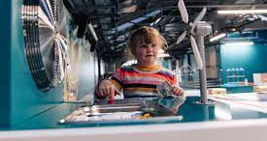
To this…

Slide 6
Covid 19 – Our response to the lockdown

Slide 7
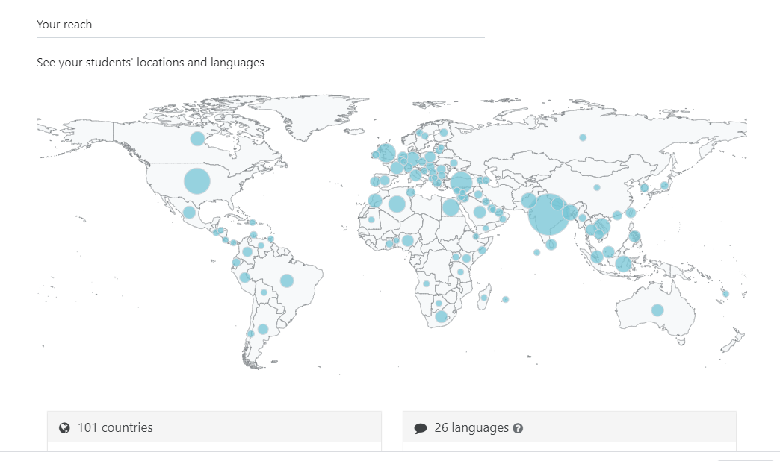

Slide 8
Why go back to in person events? (discussion)

Slide 9
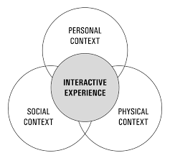
The interactive experience model (J.H. Falk and L.D. Dierking)
Personal Context
Motivation and expectations
Prior knowledge, interests and beliefs
Choice and control
Social Context
Within group mediation
Facilitated mediation
Physical Context
Advance organisation and planning
Design
Reinforcing experiences

Slide 10
Our experience shows that in person engagements:
Have a higher attendance rate than digital events
Generally have higher satisfaction rates (for participants and for our team)
Are more accessible to a wide variety of participants (no limitations related to bandwidth and/or social media use)
Engage more under-represented communities
Are more immediately responsive and build trust
Improve the quality and impact of our engagements

Slide 11
Digital fatigue

Slide 12
Moreover…
Source: How are you doing?
Children’s Parliament, November 2020

Slide 13
Moreover…
Source: Ofcom, Connected Nations 2020 report

Slide 14
Moreover…

Slide 15
Events etiquette (discussion)
How to chose the right format and venue for an in person event?

Slide 16
Venue Considerations:
Target audience
Accessibility (including location, parking and access by public transport)
Indoor or outdoor (are risk assessments compatible?)
Size (bearing in mind number of attendees, number of social “bubbles” and capacity to social distancing)
Access to facilities (e.g. hand washing/hand sanitisers, ventilation, WiFi)
Cost

Slide 17
Event Format Considerations:
What do you want to achieve?
Who do you want to reach?
What activities would you like to do?
Who will staff your activity?
What equipment do you need?
What will your target audience get out of the activity?
How will you make the activity interesting/relevant to your audience?
How will you evaluate the activity?

Slide 18
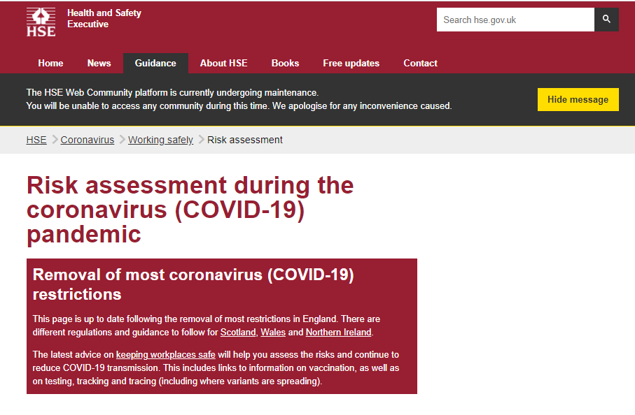
Health and Safety:
Steps:
Identify activities that might cause Covid-19 transmission
Think about who can be at risk
Decide likelihood of exposure
Identify control measures
Adequate ventilation
Sufficient cleaning
Good hand hygiene

Slide 19
Health and Safety:

Slide 20
Health and Safety:

Slide 21
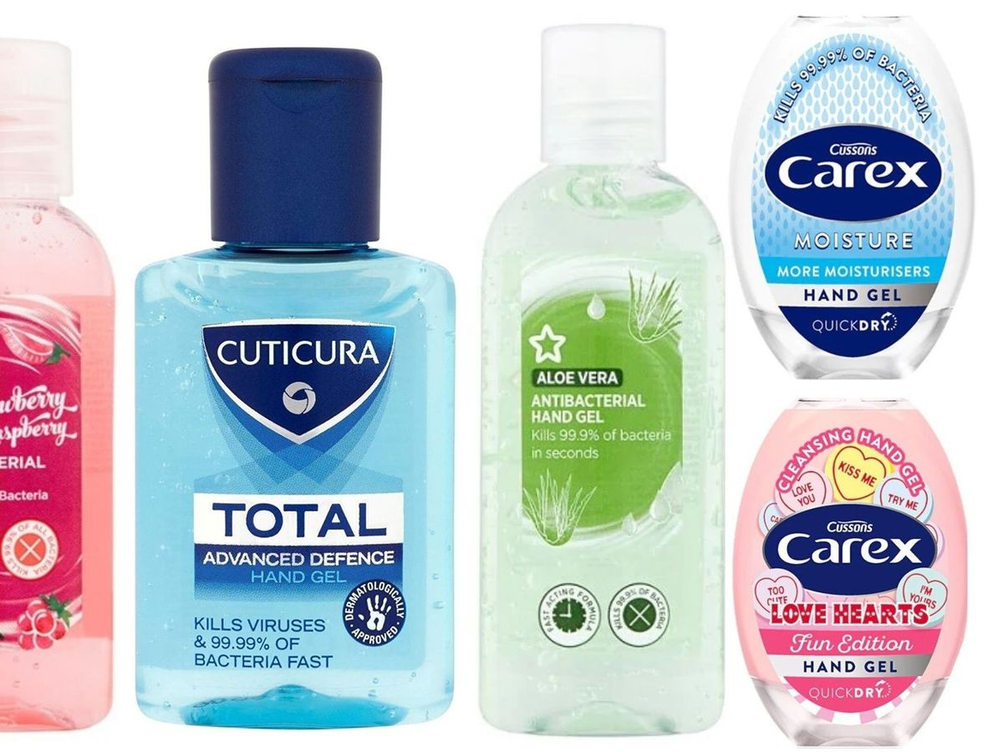
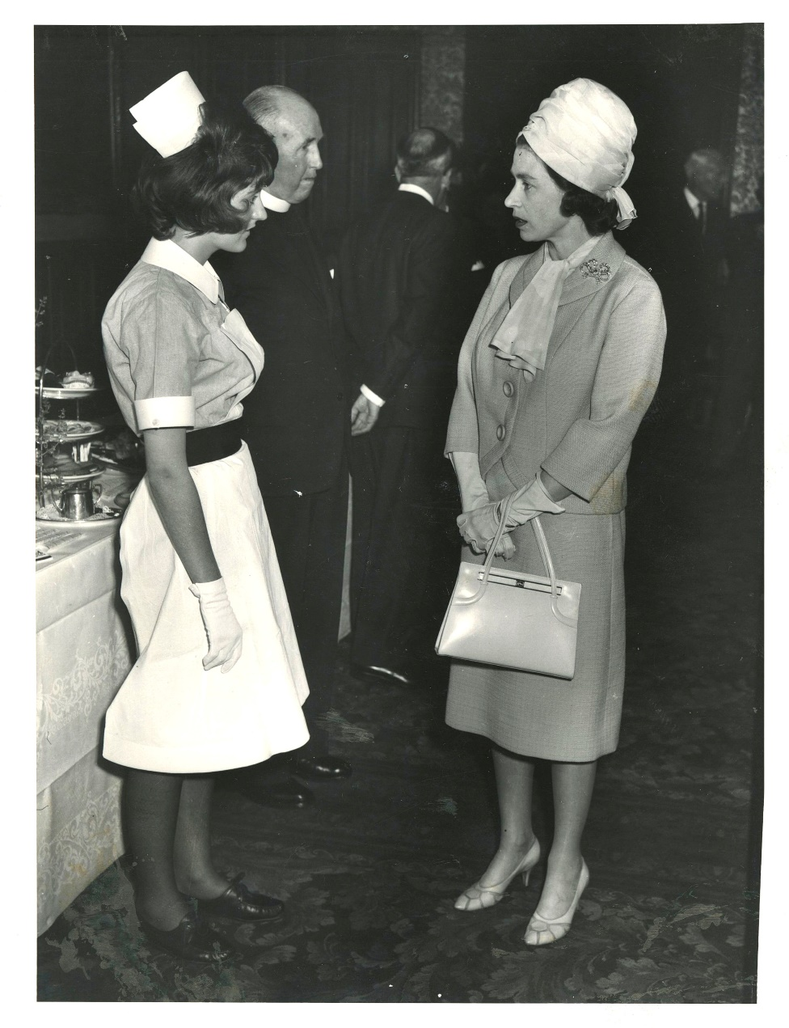
Hygiene Theatre:
Image from Press and Journal (https://www.pressandjournal.co.uk/fp/news/aberdeen/2088739/aberdeens-1964-typhoid-outbreak-school-closures-medical-isolation-and-travel-bans-have-been-weathered-before/)

Slide 22
Health and Safety (discussion):
What steps you should take to make event safe for yourself, your team and your audience? (type of event, venue, number of people, avoiding congestion etc.)
What resources would you use and how would you clean/disinfect/quarantine?
Would they be shared throughout the event?
Is there any “hygiene theatre” applicable?
How will you keep your audience informed?
How will you report any Covid-19 related incidents?
Notes:
https://padlet.com/educationASC/h3x3gqbqkjfudfy9

Slide 23
Effective Communication:
Keep community leaders and participants informed early
Ask for input in designing event format and accessibility of venue
Share risk assessments (are they compatible?)
Be flexible
Use your networks
Be thoughtful of your audiences’ needs and how they will benefit by participation
Keep a register of attendees or have a responsible individual contact NHS in case of a positive case
Notes:
https://padlet.com/educationASC/h3x3gqbqkjfudfy9

Slide 24
Why do we need to evaluate Public Engagement? (discussion)
To better understand the needs, visions and aspirations of our community
To improve our own practice and the benefits to our audiences
To evidence own achievements and our impact to our community
To convince others (e.g. sponsors, funders, PEF and policy makers) of our own achievements and impact
Notes:
https://padlet.com/educationASC/h3x3gqbqkjfudfy9

Slide 25
Feedback/evaluation:
Description
What happened?
Feelings
What were you thinking/feeling?
Evaluation
What was good about the experience?
Analysis
What sense can you make from the experience?
Conclusion
What do you need to improve on?
Action Plan
How will you improve?
Notes:
https://padlet.com/educationASC/h3x3gqbqkjfudfy9

Slide 27
Participant feedback/evaluation:
How do we evaluate the impact of our engagement(s)?
Start early, include any information regarding your audience
Be creative and paperless
Have SMART Objectives:
Specific
Measurable
Achievable
Relevant
Timely
Notes:
https://padlet.com/educationASC/h3x3gqbqkjfudfy9

Slide 28
Please fill in our feedback form

Slide 29
Additional resources
Scottish Government website (https://www.gov.scot/coronavirus-covid-19/)
Health and Safety Executive (https://www.hse.gov.uk/coronavirus/working-safely/index.htm)
The Resource Centre – Covid-19 Risk Assessments (https://www.resourcecentre.org.uk/wp-content/uploads/2021/05/Covid-19-risk-assessments-1.pdf)
Falk, J.H. and Dierking, L.D., Learning from Museums Visitor Experiences and the Making of Meaning. 1st edition. Altamira Press
Falk, J.H. and Dierking, L.D. The Museum Experience. 3rd paperback edition. Routledge Taylor and Francis group
McArdle, K., Briggs, S., Forrester, K., Garrett, E. and McKay, K. The Impact of Community Work How to Gather Evidence. 1st edition. Policy Press

Slide 30
Additional resources
Planning your Public Engagement, Welcome (https://wellcome.org/grant-funding/guidance/planning-your-public-engagement)
Evaluating Public Engagement, National Co-ordinating Centre for Public Engagement (https://www.publicengagement.ac.uk/do-engagement/evaluating-public-engagement)
Public Engagement Evaluation Framework, Science and Technology Facilities Council (https://stfc.ukri.org/files/corporate-publications/public-engagement-evaluation-framework/)

Slide 31
Further details on past and future SWEA workshops:
https://www.scotpen.org/swea-public-engagement-training

